Slide 1
3
Interdependence and the Gains from Trade

Slide 2

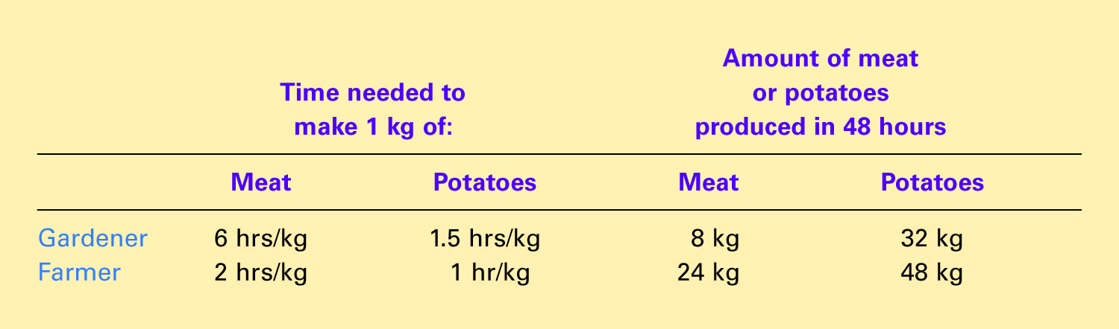
Table 1 The Production Opportunities of the Farmer and Rancher
Copyright © 2004 South-Western

Slide 3

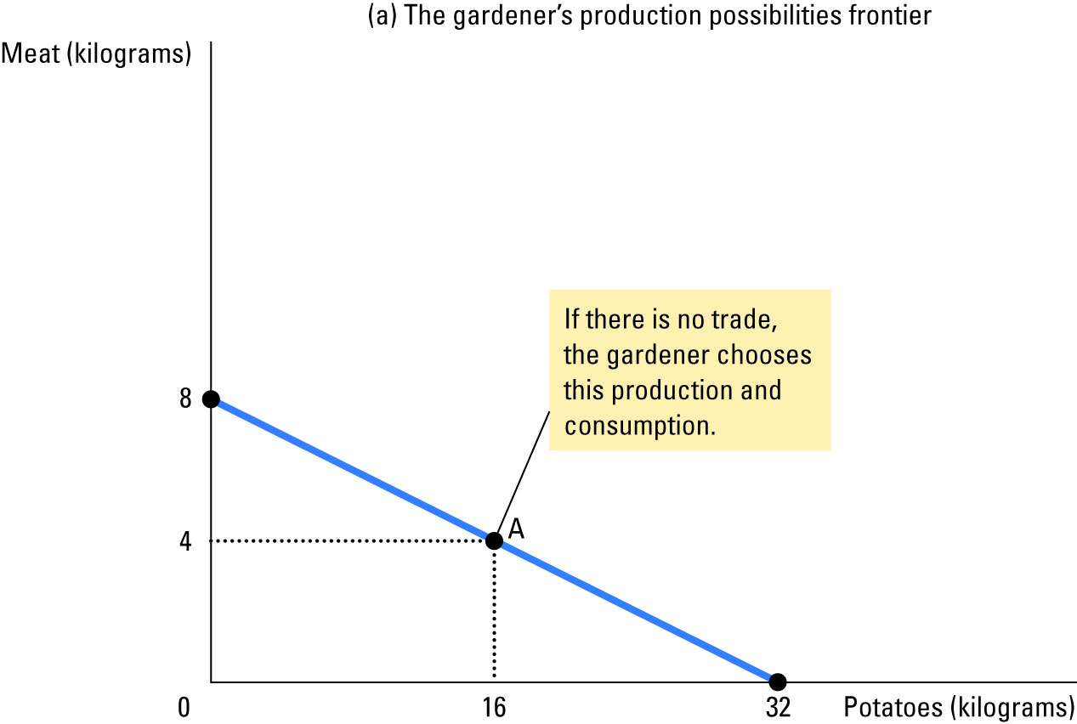
Figure 1 The Production Possibilities Curve
Copyright©2003 Southwestern/Thomson Learning

Slide 4
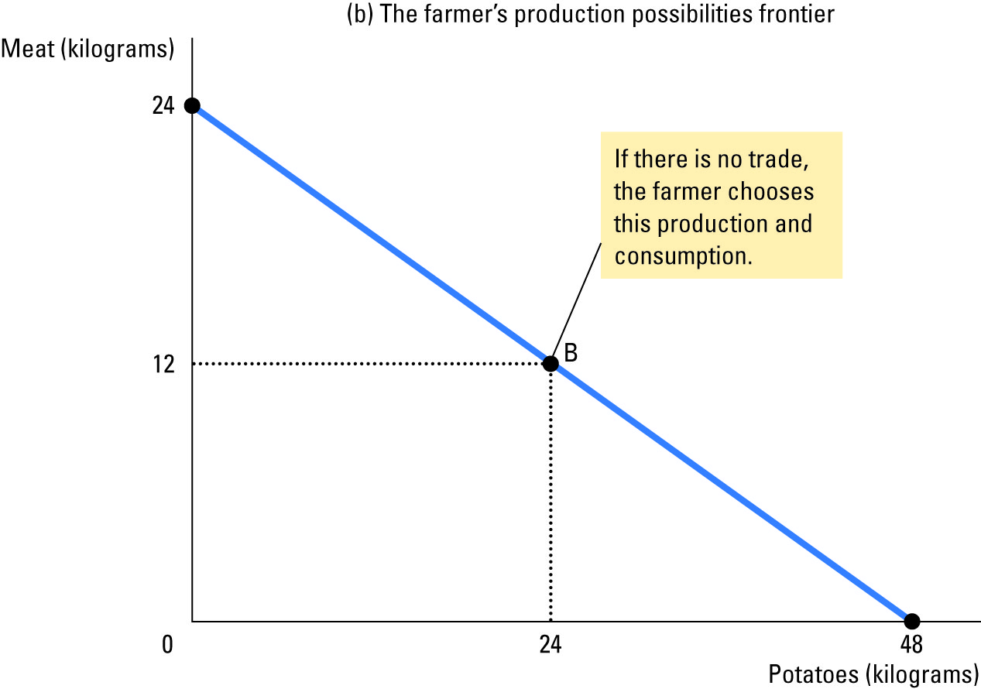
Figure 1 The Production Possibilities Curve
Copyright©2003 Southwestern/Thomson Learning

Slide 5
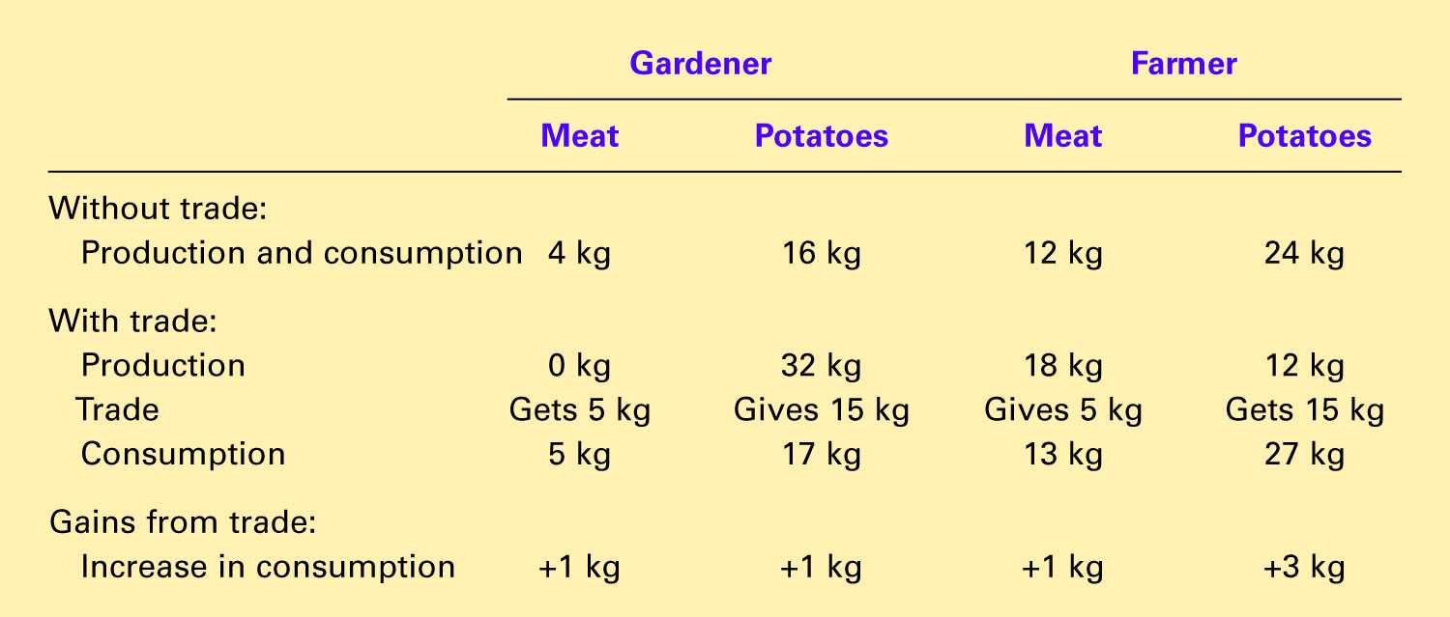
Table 2 The Gains from Trade: A Summary
Copyright © 2004 South-Western

Slide 6
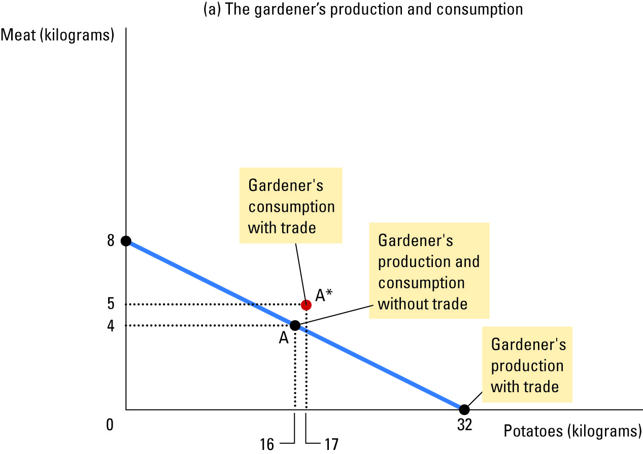
Figure 2 How Trade Expands the Set of Consumption Opportunities
Copyright©2003 Southwestern/Thomson Learning

Slide 7
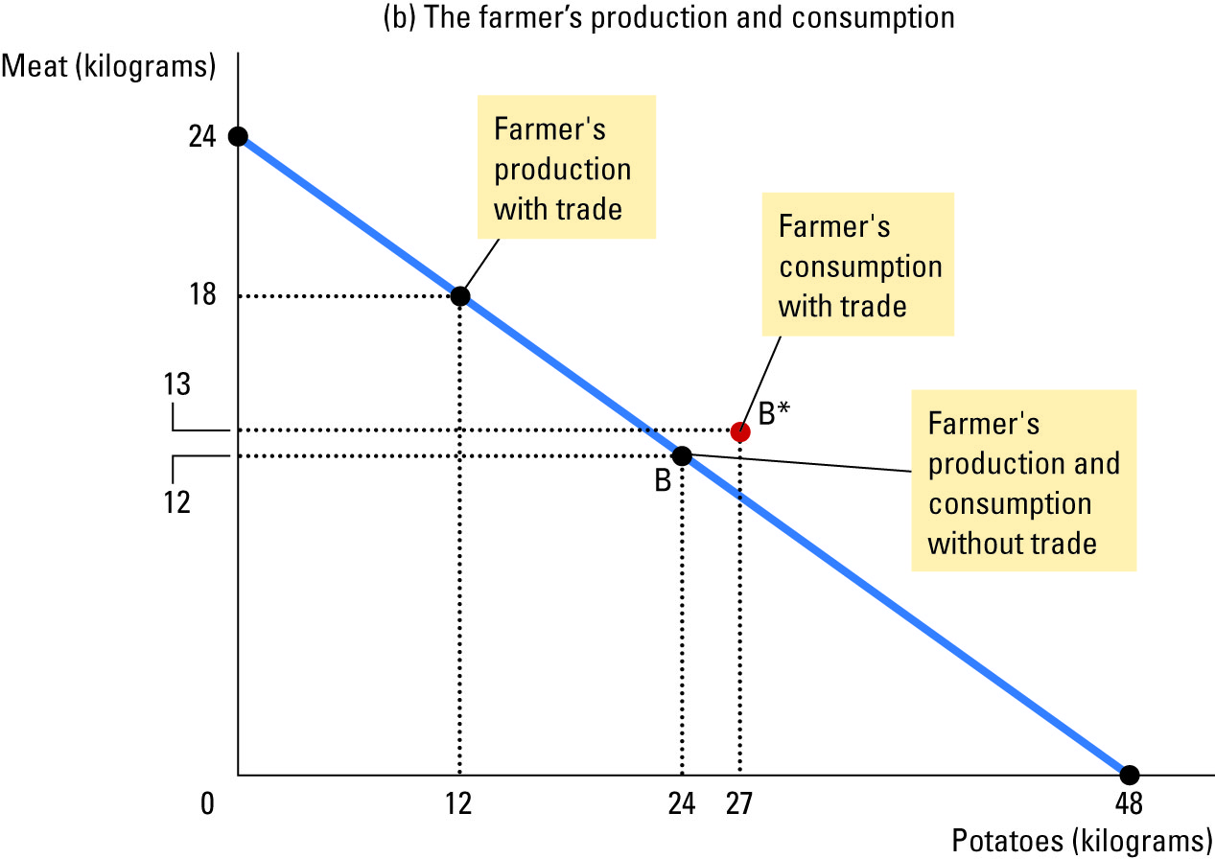
Figure 2 How Trade Expands the Set of Consumption Opportunities
Copyright © 2004 South-Western

Slide 8
Table 2 The Gains from Trade: A Summary
Copyright © 2004 South-Western

Slide 9
Table 3 The Opportunity Cost of Meat and Potatoes
 | Opportunity cost of:
 | 1 kilogram of meat | 1 kilogram of potatoes
Gardener | 4kg of potatoes | 0.25kg of meat
Farmer | 2 kg of potatoes | 0.5kg of meat

